Slide 1

Introduction to Web Scraping
Innovation COE: 29th August 2023

Slide 2
Contents
What is web scraping
Review HTML and CSS
Programming Basics - Python
Web scraping with BeautifulSoup in Python
Summary

Slide 3

What is web scraping

Slide 4
Data collection
Web scraping is a technique used to extract data from websites
Purposes
Data collection and analysis
Content aggregation
Social listening
Language processing and machine learning
Government data collection
Etc.

Slide 5


Web scraping step
Requesting web pages
Downloading web content
Parsing HTML
Extracting data
Data cleaning
Storing data
Cascading Style Sheets
Hypertext Mark Language

Slide 6
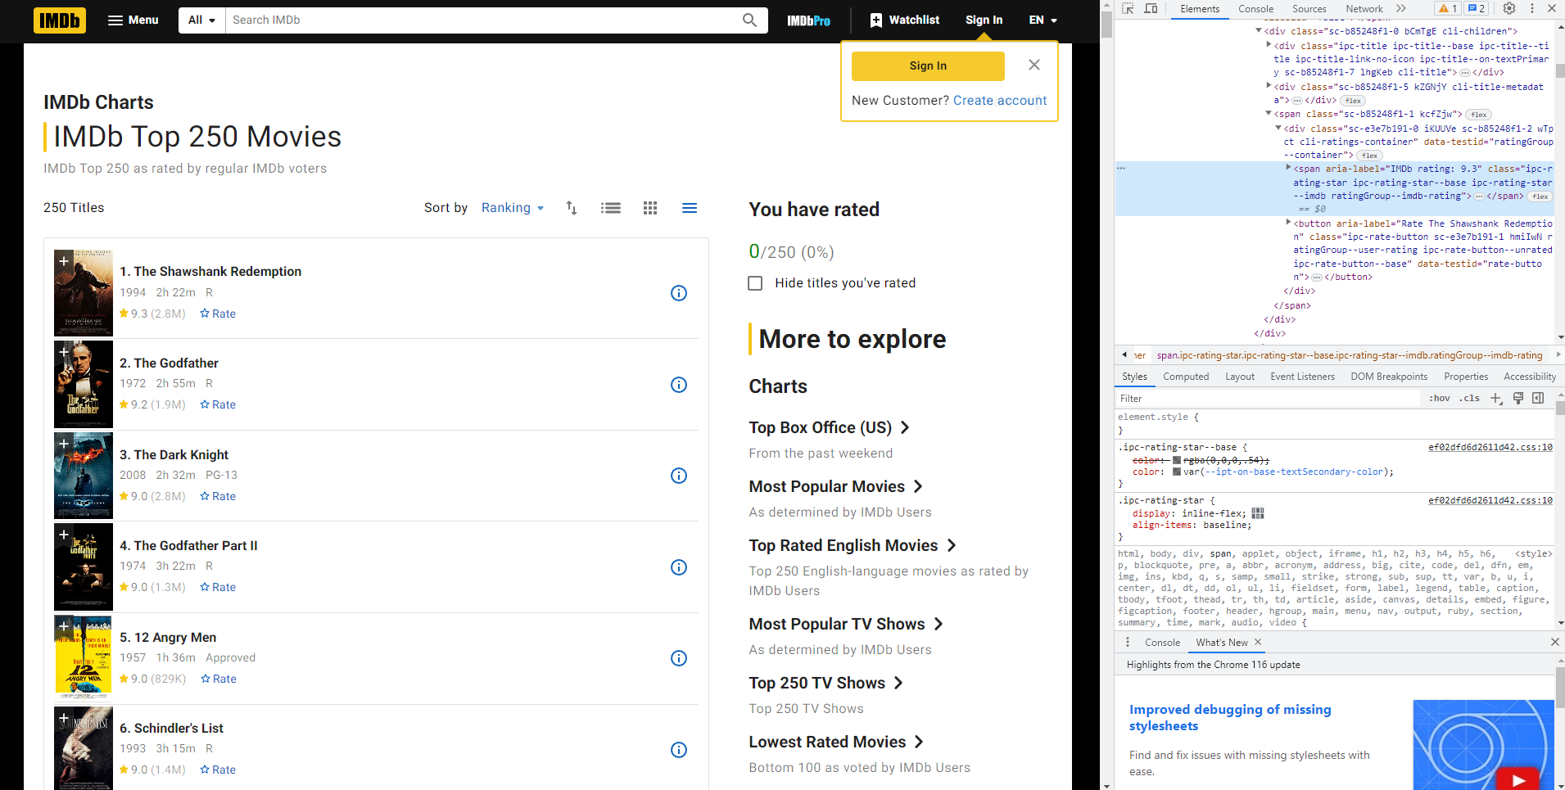

Slide 7
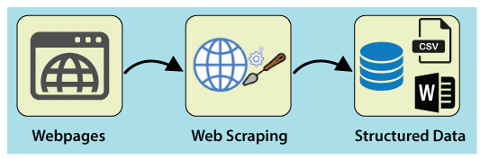

Slide 8

Intro to HTML and CSS

Slide 9
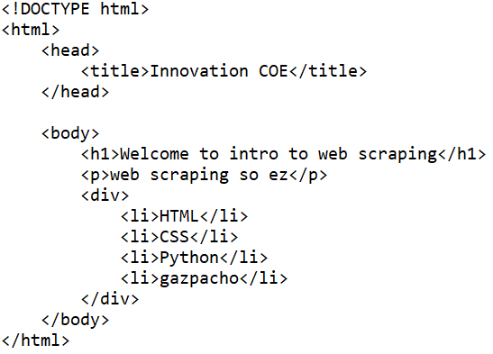
Html link:
https://gist.githubusercontent.com/ppr22747/9de3dc39065e434af5fcdd0fc7b6ff99/raw/cd4c2bde7a9c73b69493eff6a66bec4db02457f0/basic_html.html

Slide 10
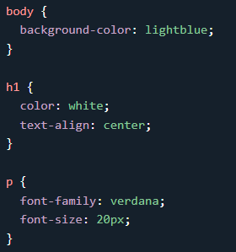
Html element
style
<head>
<link rel="stylesheet"
href="styles.css">
</head>

Slide 11

Programming Basics - Python

Slide 12

https://colab.research.google.com/

Slide 13
Variable
x = 10
y = 20
print(x + y)
my_name = ‘weerapat’
my_department = ‘AME’
my_age = 22

Slide 14
Function
def hello():
print(‘Hello World!’)
hello()
----------------------------------------------------------------------------------------------
def rectangle(w, h):
print(w *h, ‘square meter’)
rectangle(5, 3)

Slide 15
Data type
List
ls = [1, 2, ‘name’, ‘lastname’, ‘13’] ➔ mutable
Tuple
tp = (‘id’, ‘12345’, 2147) ➔ immutable
Dictionary
dict = {
key: value
‘name’: ‘weerapat’
‘department’: ‘AME’
‘age’: 22
}

Slide 16
Control Flow: for loop
# for loop
# know No. of loop
for i in range(1, 10):
print(i, ‘Hello world’)

Slide 17
Control Flow: if else
# if else
# condition
score = 85
if score >= 80:
print(‘score =‘, score, ‘you got “A” !!’)
elif score >= 50:
print(‘score =‘, score, ‘you got “C” !!’)
else:
print(‘score =‘, score, ‘you FAILED!!’)

Slide 18

Web scraping with BeautifulSoup in Python

Slide 19


BeautifulSoup
import requests
from bs4 import BeautifulSoup

Slide 20
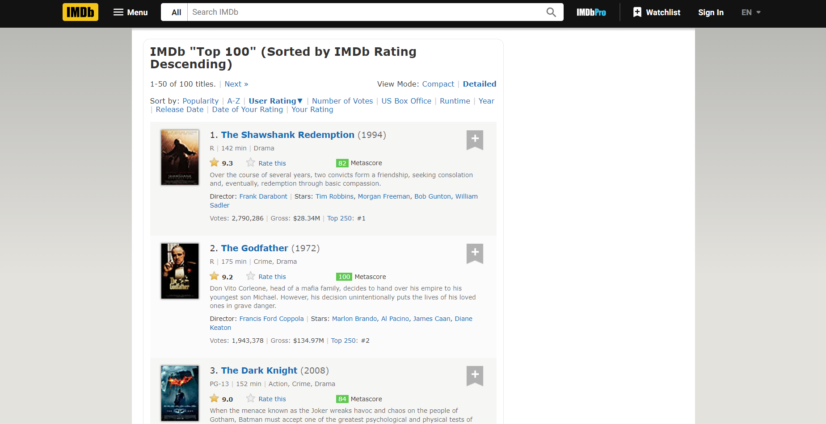
url = 'https://www.imdb.com/search/title/?groups=top_100&sort=user_rating,desc’ response = requests.get(url) html = response.text soup = BeautifulSoup(html, 'html.parser')

Slide 21
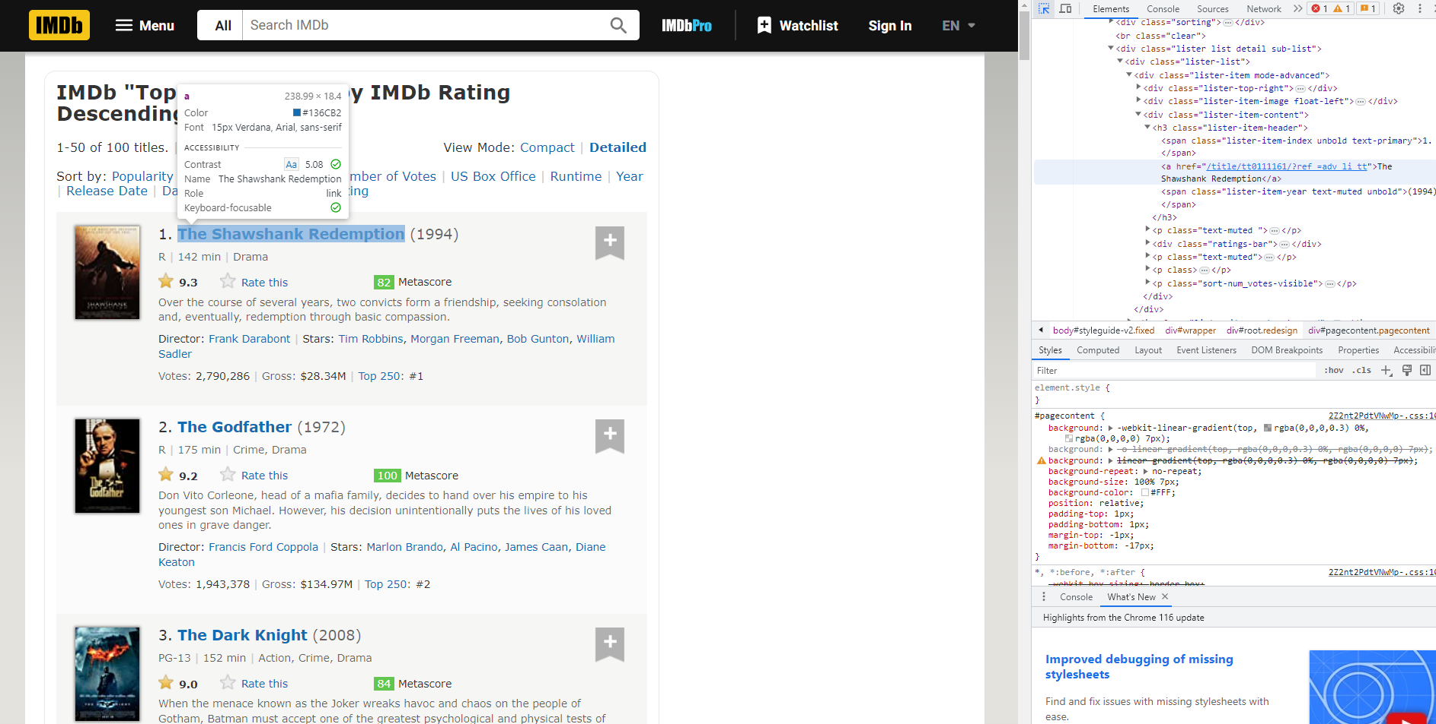
movie_name_anchors = soup.select("h3.lister-item-header a")
movie_names = []
for anchor in movie_name_anchors: # Loop through each <a> element in the list
name_text = anchor.get_text() # Get the text content of the <a> element
movie_names.append(name_text) # Add the movie name to the list of movie names

